Slide 1
the NATURE of CITIES
How to see an Elephant!
Viv Grigg

Slide 2
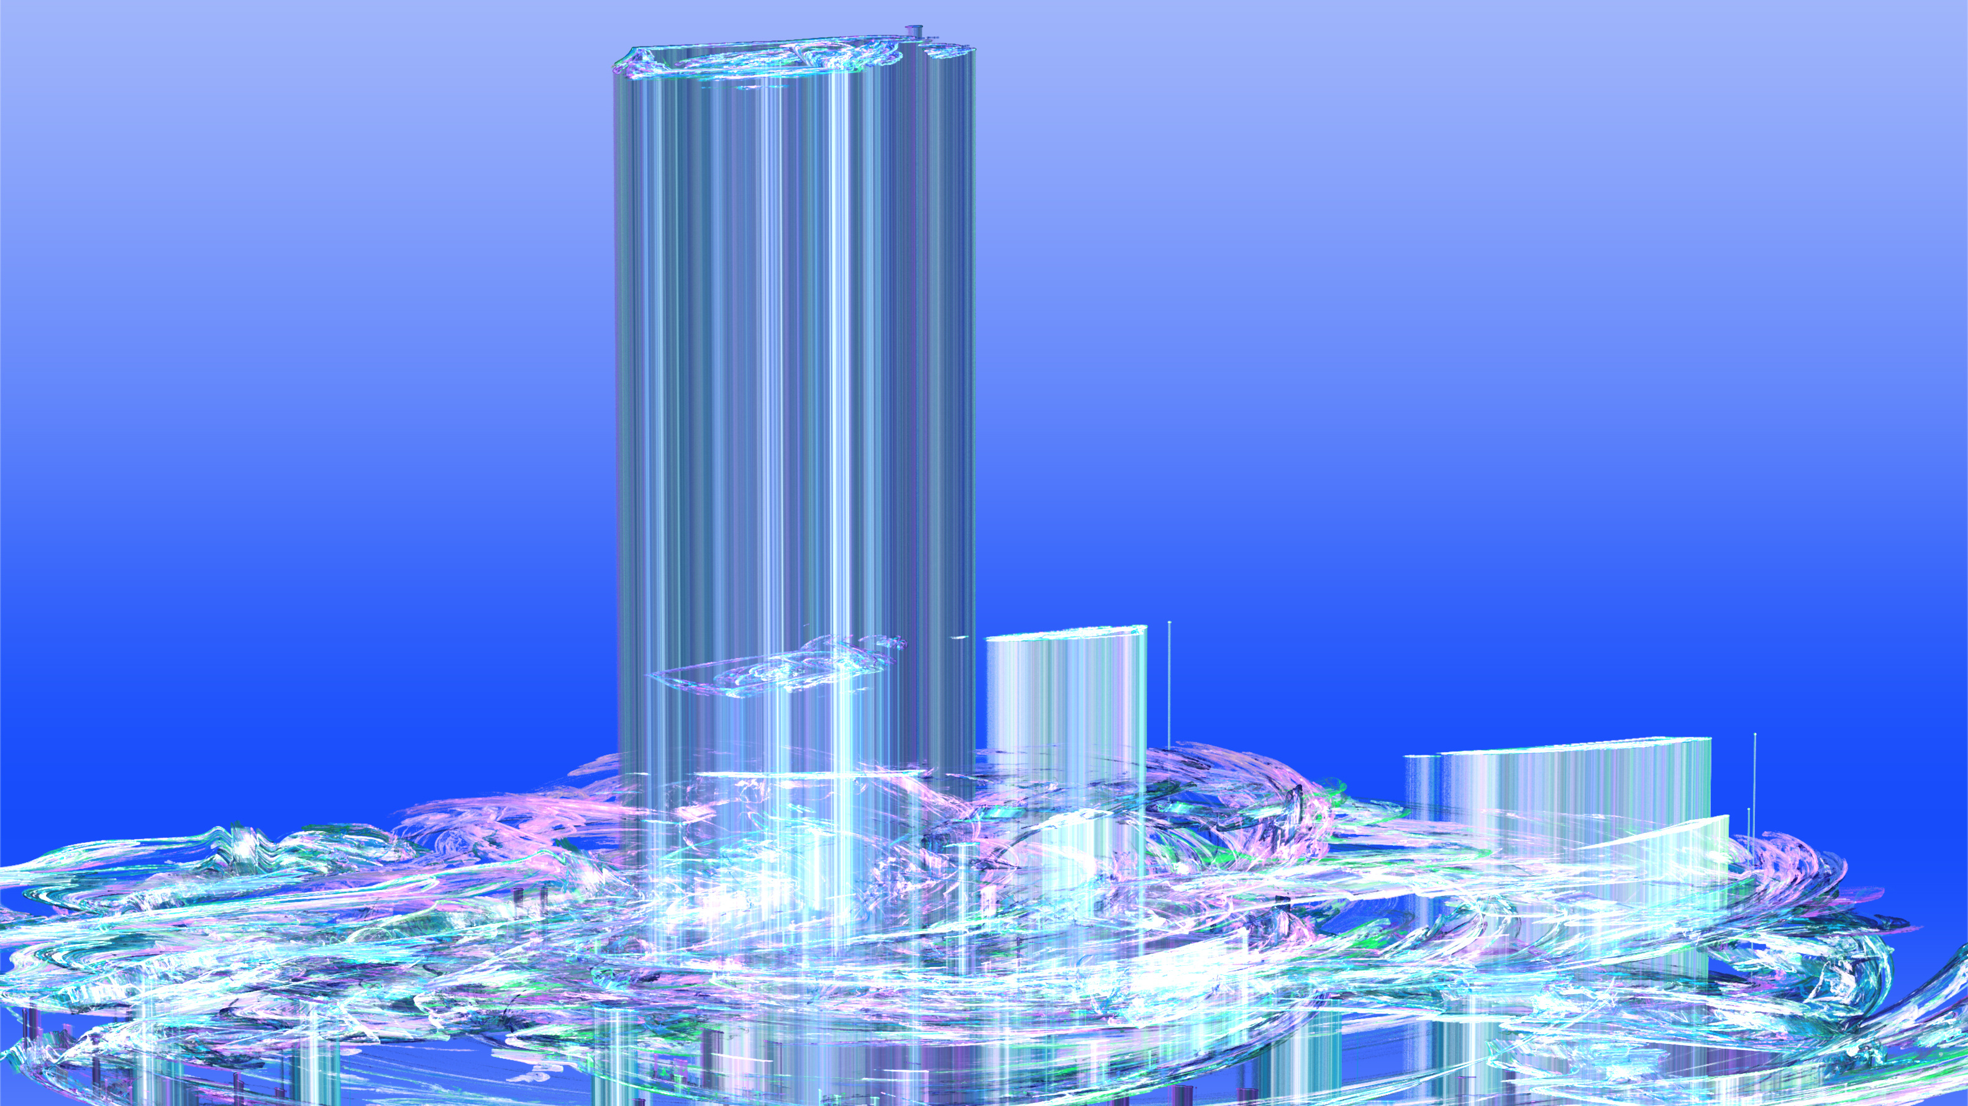

1
INTRODUCTION

Slide 3
Welcome to Our Presentation
Ways of seeing!!
Changing Glasses!
Cities or Cultures can be viewed in multiple ways, bifocals become multiplex. Each way becomes an academic discipline! Within each discipline specific philosophies build concept upon concept! Tools develop to explore each of these concepts! New language is created to speak within that discipline! Implications for action are developed! Heroes of the schools of thought become public voices through significant action that engages critical human need!
In this unit we are looking at cities as a whole!

Slide 4
Table of
Contents
Introduction
Ways we See
Cities as Rainforests
Multiple Organic Layers
Cities as Concentrations
The Demographics of Cities
Cities as Amoebas
Expanding Organisms
Cities as Parties
Social Systems
Cities as Technique
The economic defining of technological humanness

Slide 5
Table of
Contents(2)
Cities as Providers: Economic Units
Economic Units
Cities as Order
Social Controls
Cities as Soul
Integrators of Cosmic Meaning
Cities as Goddesses
The Poetry of Artistry
Cities as Thought Processes
The Mazeways of the Urban Mind
Integration

Slide 6
An Alternative: Analyzing Culture
Introduction
Ways we See
Cultures as Rainforests
Multiple Layers
Cultures as Concentrations
The Demographics of Cultures
Cultures as Amoebas
Culture as Organisms
Cultures as Parties
Cultures and Social Systems
Cultures as Technique
The economic defining of technological humanness

Slide 7
Table of
Contents(2)
Cultures as Providers: Economic Units
Economic Units
Cultures as Order
Social Controls
Cultures as Soul
Integrators of Cosmic Meaning
Cultures as Goddesses
The Poetry of Artistry
Cultures as Thought Processes
The Mazeways of the Urban Mind
Integration

Slide 8
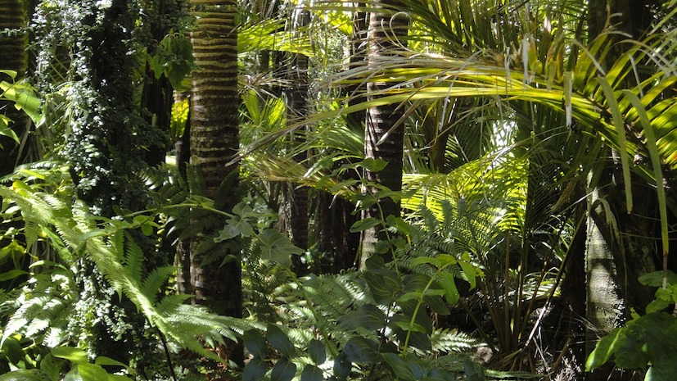

2
CITIES as RAINFORESTS

Slide 9
Cities as Rainforests
Inerconnectedness, stratification
Urban problems abound filling the news: safety on the streets, educational chaos, traffic congestion, rising crime, the sudden loss of a water supply, slums, urban financial rip-offs. Each problem is grappled with in isolation. But we need to look for the deeper levels of interconnectedness.
A city is like a rainforest. Down at the grass-roots where we live most of our lives helping damaged individuals to dream new dreams, we see only the grass of our little suburb, and ministry, the roots of some neighboring tree which overshadows that grass and occasionally the beautiful plumes of a bird in full fight above us or the dim rays of the distant heavenly light of a Father who superintends this city. Layers, Levels, Vertical Divides

Slide 10
City as Rainforest
Poverty, Oppression, Pain as the Driving Questions
One urban problem dominates others - poverty - that problem particularly of the ethnic minorities, where the majority of unemployment, crime, and ghetto-ization occur. As we walk with Jesus in the midst of it, the question of poverty drives us to the deepest levels of interconnectedness of philosophy. For the problems are not in the neighbourhood or in the ethnicities but in the city itself for "Happy" city has "Oppressed" ethnic minority.
Discordant Functions Create both Artistry and Poverty
Thus we must raise our eyes, at least to the level of the undergrowth and then beyond into the level of the grand trees that make up the forest and look at the several discordant functions of the city. For the major functions are often in conflict. It is this series of related conflicts which creates the pain, the complexity and the artistry of the city (isn't the best art is found in the contrasts).

Slide 11
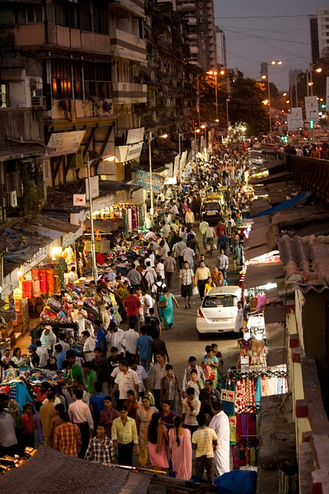

3
Cities as Concentrations:
The Demographics of Cities

Slide 12
More Persons in Less Space
Cities like rain forests are high density clusters of trees (people). Calcutta for example is 58,000 people per square mile. While the 1000 people per square mile approx. of the greater Auckland area hardly compares, both in their contexts are significant concentrations.
Prior to the modern urbanization process, man had fulfilled the mandate to fill the earth and subdue it (Genesis 1:28), by scattering across it. From that time on his task has been from concentrated nerve centers. The urban forest has become the nerve center of the rural farmland.

Slide 13
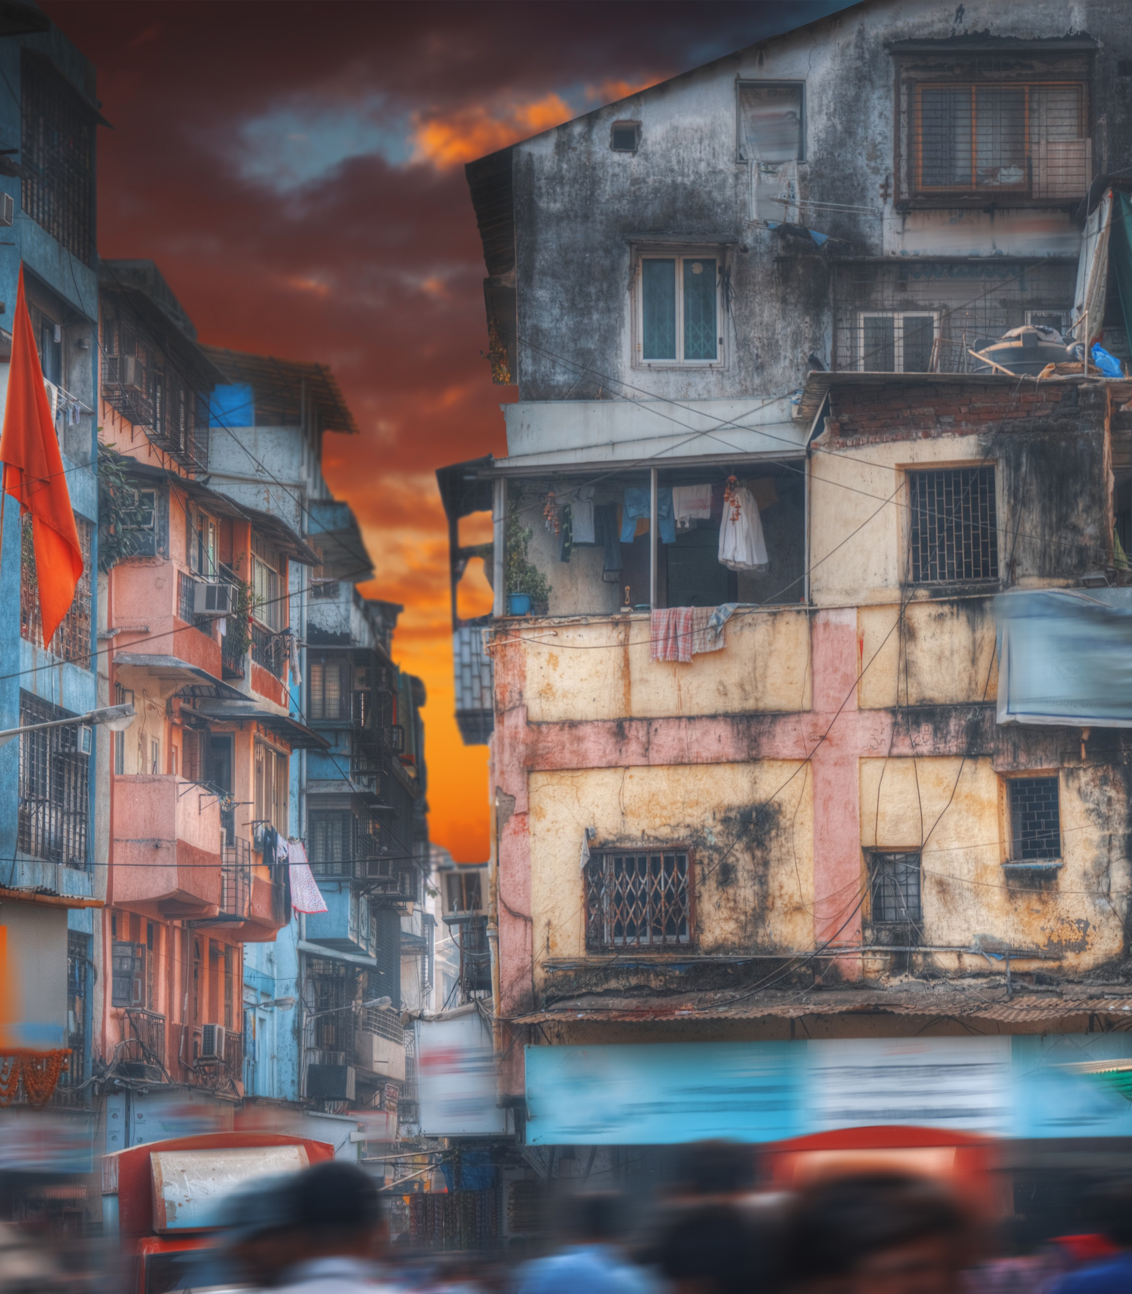
Spatial Arrangements of The City
God consistently pays great attention to fixing the boundaries of the habitation of the peoples (Deut 32:8). How he does this in cities is a matter of wonder, for it as if a hand outside of humankind has generated patterns into which we fall.
Urban geography is a great study of these processes of God’s activity.
Ultimately the scriptures speak of a cubic city, 1000 stadia high, 1000 stadia long, 1000 wide. Is it only symbolically complete, space maximized, or perhaps it will actually be this shape? Certainly the world’s population can fit one family per cubic stadia.

Slide 14
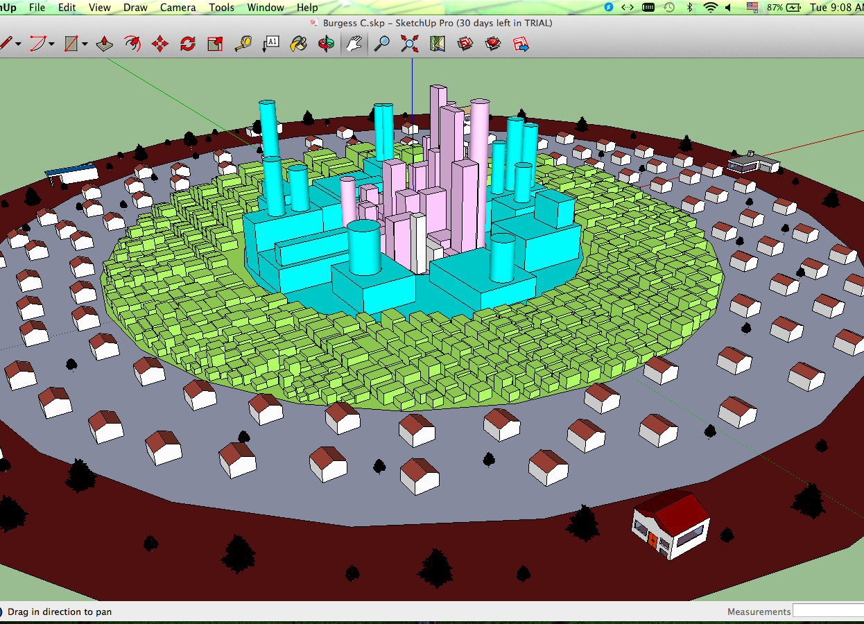
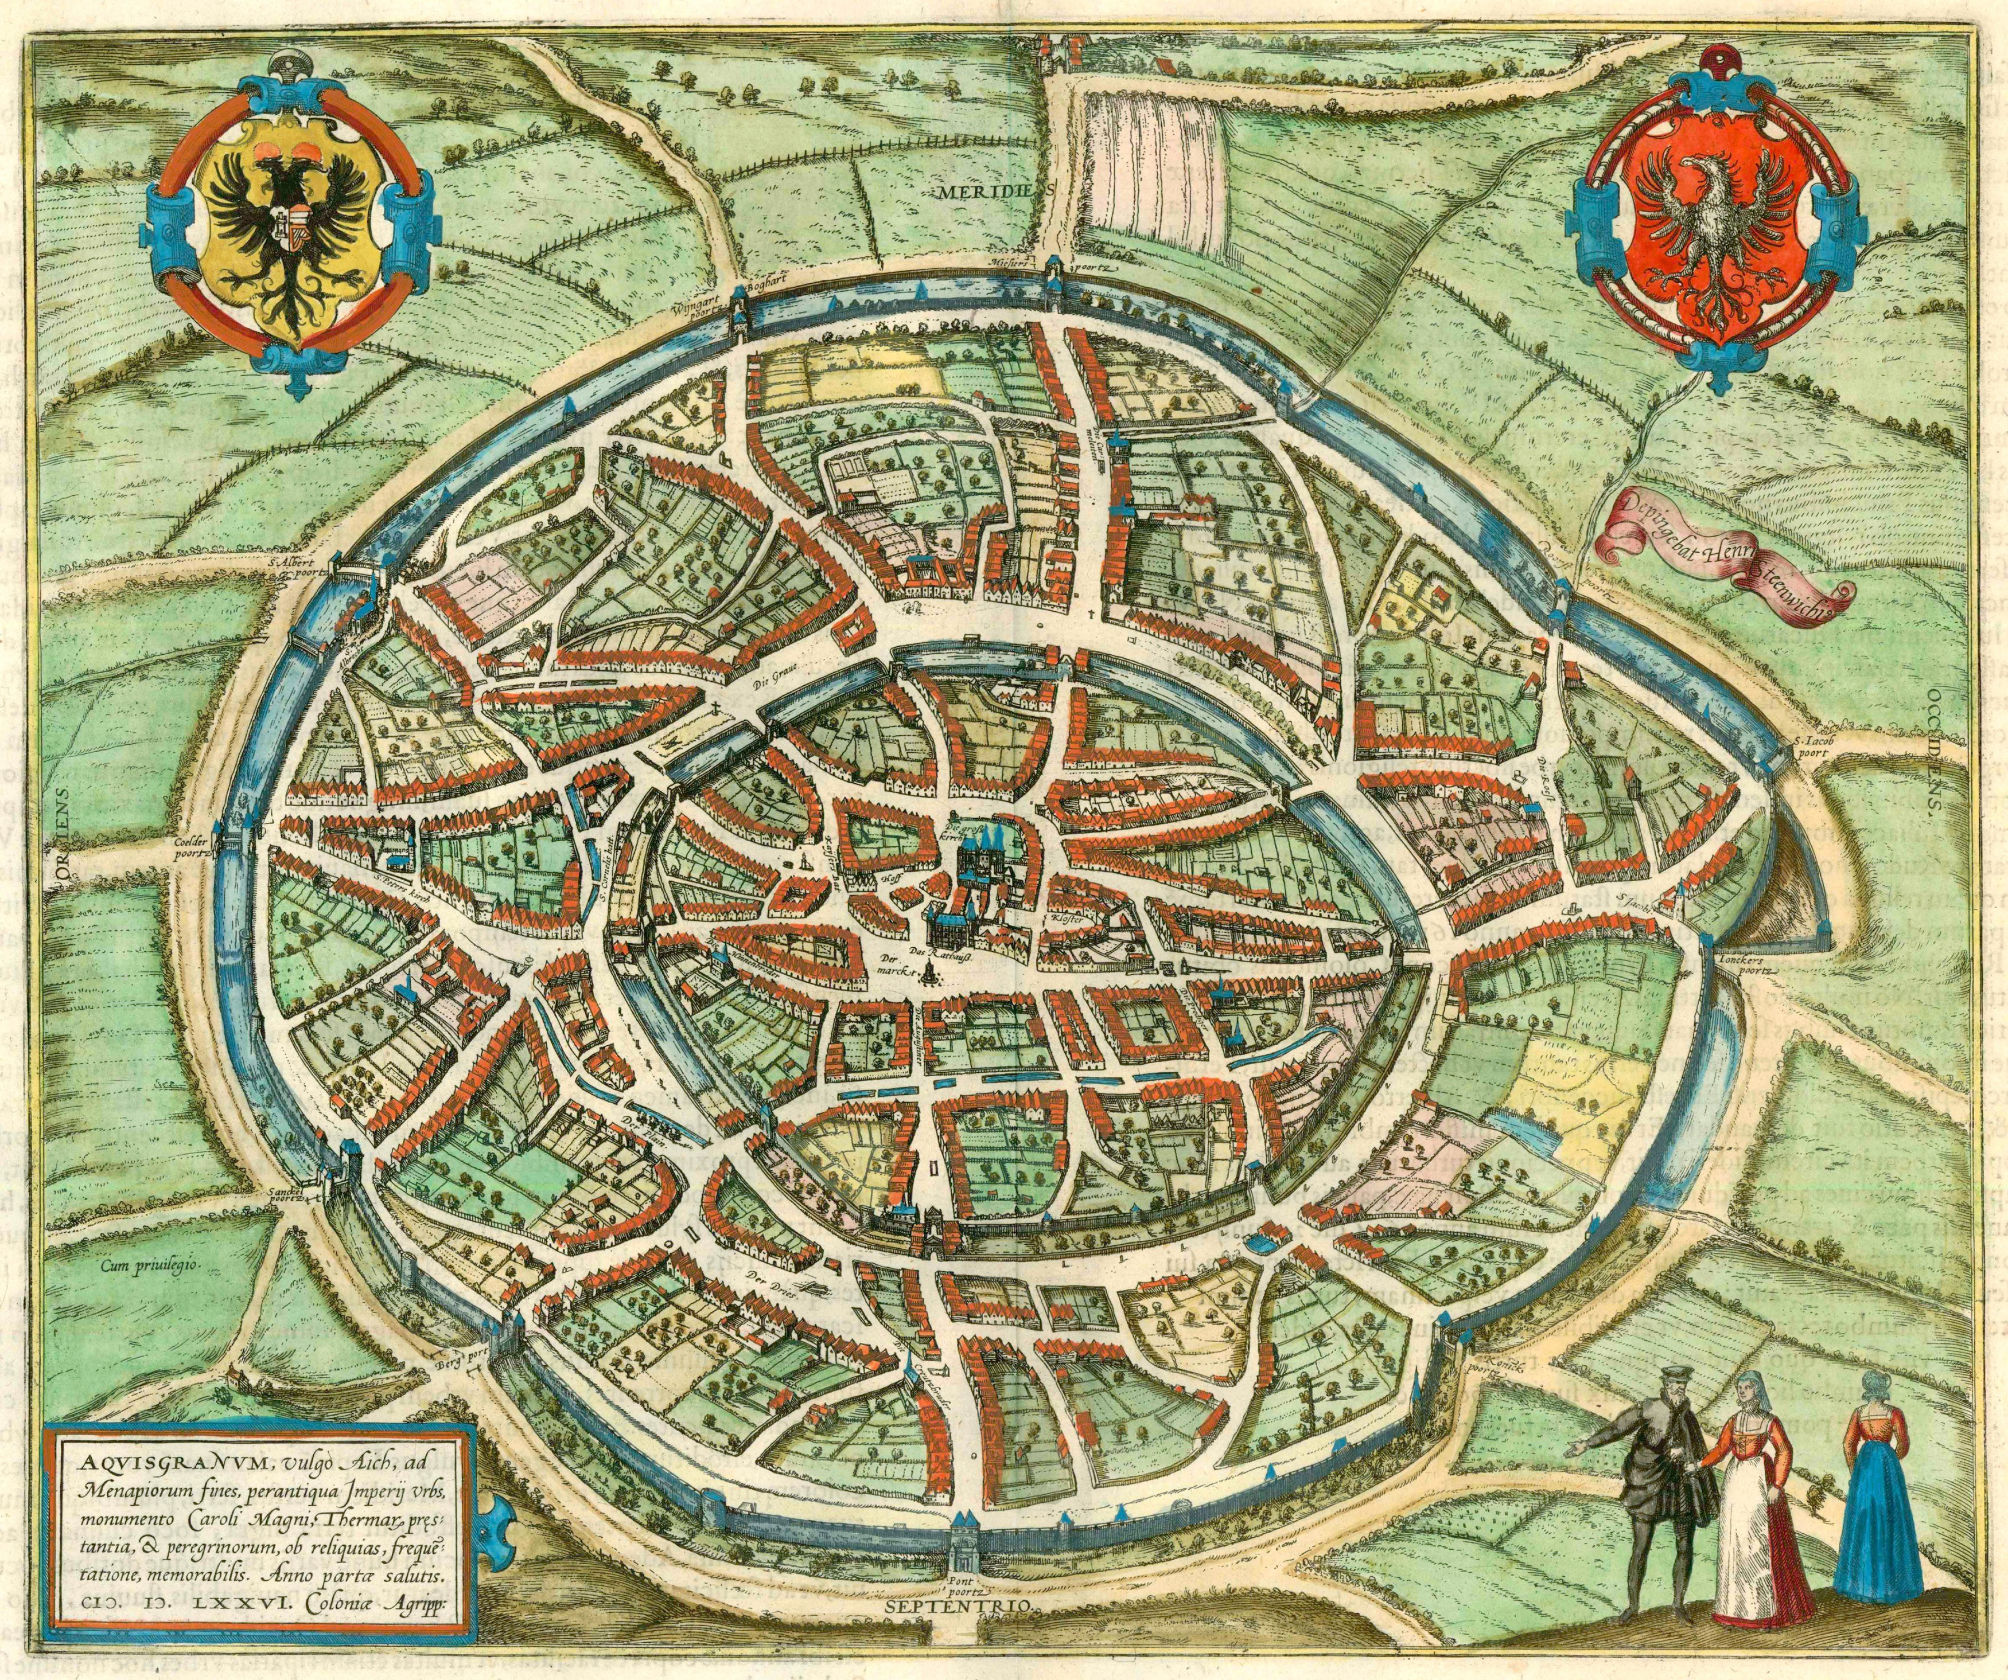
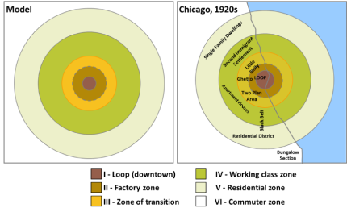
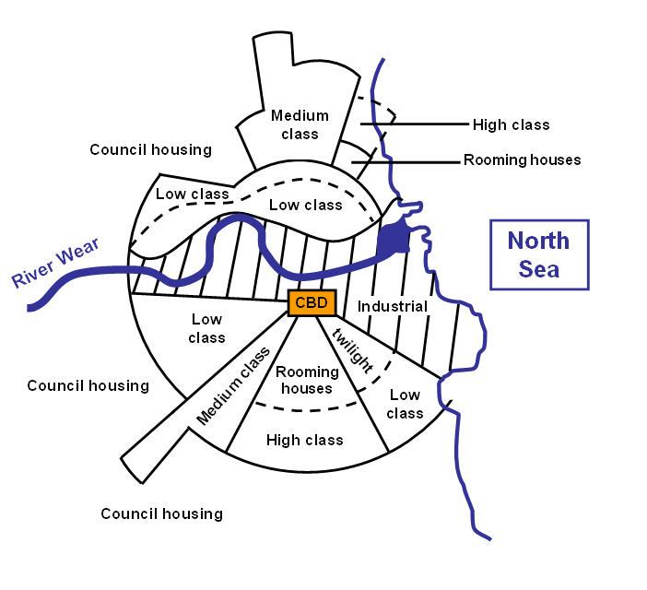
Concentric
Burgess proposed a model of the American city where the value of space decreases from the centre. The centre is thus restricted to business interests. workers, seeking to live near their work.
Around this is a no-man’s zone owned by speculators waiting for the city to expand and allowing housing to decay while renting it. A third belt is industrial workers, seeking to live near their work. Beyond this are residential areas.
Burgess, E.W. 1925 The City, Chicago: University of Chicago Presshttps://madagascargeo.wordpress.com/2015/05/01/city-models-burgess-concentric-ring-model/

Slide 15
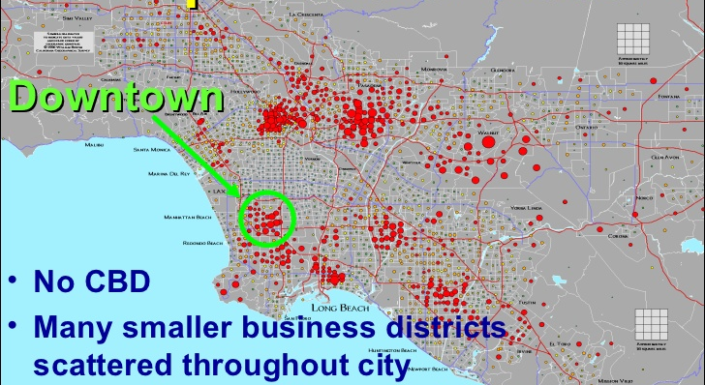
Sectoral to Multiple Nuclei
In this Sectoral model the availability of land is determined by the radial arteries radiating from the center of the city.
Manila shows another model, where five major city centers have deliberately been determined as the place of new growth based around certain leading industries. Between these cities squatter areas emerge in the as yet unused land waiting for the urban expansion.
Los Angeles is the ultimate in a city without a center, a multiple nucleatic conurbanization.

Slide 16
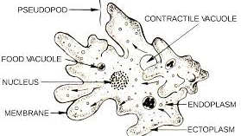

4
Cities As Amoebas:
Organisms

Slide 17
City growth patterns?
A city comes into being by growth, rather than by design (with occasional exceptions such as Canberra , or Brasilia). So it has various stages of construction and inadequacy. These are a sign of its vitality, just as a healthy tree has multi-hued falling leaves, in the midst of new shoots, and a healthy forest has a jumble of fallen branches and logs from which new plants take root and grow.
The growth has life, that breath of life breathed into mankind, multiplied a thousand thousand times. The life of God, not dissimilar to the life which sustains the rain forest in its patterns.
Cities as Amoebas

Slide 18
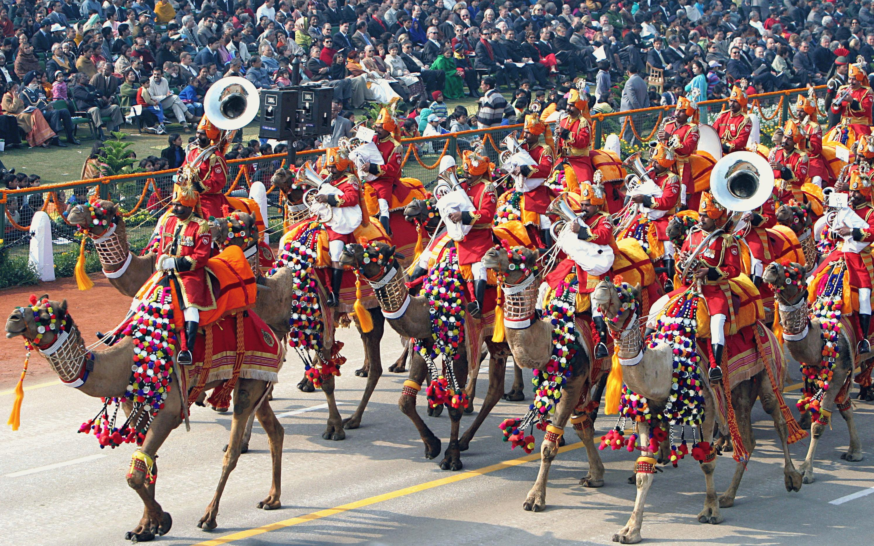

5
Cities as Parties:
Social Systems

Slide 19
Cities as Parties
Social Dyanics
Cities as Parties
Ethnic neighbourhoods
That life has fire, passion, noise, celebration, communication. And that is broken into subsets. But the subsets- communities, neighbourhoods, ethnic groups - do not define the whole. The interrelationships between the communities and to the whole are more important than the communities themselves. Social defines “when people interact”, and the networks between people and groups end up as the “structures” of the city. “Social group” defines persons who find and feel themselves together with a common identity differentiating themselves from others.
People need to be loyal members of a well defined group, need to be emotionally attached to some tribe, clan, or community. They feel lost when they cannot do so. As migrants enter the city, the very processes of rejection by the residents who can not understand them, thrusts them together into their own supportive communities.
Socio-economic communities
The non-social workplace
Another process occurs, as communities of similar socio-economic values form, to some extent because the banks and developers cluster communities by the level of their bank accounts, to some extent by the inclination or necessities of the families. Poor families may not choose Otara - but economics may. But immigrant Indians with money choose Hillsborough because near here are the best schools, and a primary motivation for their migration is education of their children.
These clusterings of the night erupt down the motorways early in the morning to reconfigure themselves in workplaces. Here race, ethnicity, social class, and economic success are no longer the determining factors as how relationships cluster. These are the contexts of social mobility. But generally these are secondary relationships, relationships of economic necessity rather than those of choice.

Slide 20
Art Design
Web Design
Programming
Publishing
Consultant
Management
Sales Chart
An interesting side issue here is the failure of urban mission of a generation past which focused on mission in the workplace. Noble, and well thought through attempts were made across the Western world to establish patterns of ministry among industrial workers. But today we hear little of these attempts. It is facile to say that this may be because of the powerlessness of liberal theology from which they emerged and which emphasized presence but not proclamation. A deeper level of analysis indicates that even where attempts involved a healthy Biblical view of the evangelistic mandate, they foundered because the workers’ primary relationships focused around family and geographic community.
Notes:
No Slide Master
Double click to edit the bar

Slide 21
Solving ethnic tension?
One Urban Tension
Self-sufficiency
US Ethnic City
Thus there is a tension between the ethnic integration in the economic realm and the separation of ethnic communities in the social realm.
Ultimately the community organisation of the ethnic communities into self-supporting economic and political power contexts within the wider diversity is the key to racial harmony.
"a cluster of ethnically distinguished neighborhoods whose members collaborate in staffing the firms, markets and other economic and political organizations of the city. Economic co-operation brings the members of the diverse ethnic communities into intimate and daily contact with each other. Social predilections separate them at the end of the day..."
Significant Ethnic Niche
Source
Dorfman advocates that the healthy survival of an ethnic group depends on its ability to acquire influential if not dominant positions in some significant market in the city.
Dorfman, Robert
1970 "The Functions of the City", In Thinking About Cities: New Perspectives on Urban Problems, Anthony H. Pascal, ed., The Rand Corporation.

Slide 22
6. Cities as Technique
The Defining of Modern Urban Man and Woman
The rapid expansion of the city over the last century has been closely related to the multiplication of technological innovation
Man is not independent of the land from which he comes and to which he returns. Ash Wednesday reminds us of that, reminds us that we are defined by the land and hence by technology which is an extension of man’s relationship to the land. The technology becomes master.
Would Los Angeles exist independent of the invention of the freeway
Technology defines the patterns of our humanness
Jacques Ellul, the great Christian French urban philosopher, sees this as destructive.
It is technology that largely differentiates the characteristics of rural and urban persons.
Could you have New York as a mega-city prior to the invention of the elevator?
Similarly the nature of technology of any given city defines a person as against that technology in another city. By the same token, the levels of similarity of technology globally define the universal modern urban man.

Slide 23

7. Cities as Providers
Economic units
Production
69,478
The produce of the land, its fruitfulness provides the food, the minerals, the chemicals, the computer chips that allow for increasing economic development. This is godly, part of our involvement with his ongoing creativity.
Products
55,245
In stores
32,756
Center of Markets
Bought
Cities house markets, which depend on numerous contacts and flows of information. Each city is the center of a market of one sort or another: London as banking center, Hollywood as movie production center, New York as fashion center, Calcutta as center of Hindu philosophy.
24,119
Ongoing contact
Notes:
No Slide Master

Slide 24
8. Cities as Order
Social Controls
2. Citizenship and Legitimacy
In apportioning resources, who has the legitimate right to those resources? If we take land for example in a squatter community, the first appeal is by the owners of that land to the right of private ownership. Hence the squatters must be dispossessed of what is illegally theirs. But this line of argument is in conflict with a higher law, the fundamental right of all to a space to live worthy of their humanness. If the rich landowner makes the land a piece of (selfish, excessive, usurious) speculation and in the process tramples on this basic need for the migrants to find somewhere to live, his legitimacy is reduced on both counts.
In some cities this is exacerbated by the lack of citizenship of the migrant until he has legitimate rights to a piece of land. Until then he does not belong. He is thus disenfranchised of all legitimacy, without a viable way of entrance.
Responding to the dehumanizing effects of such an approach, cities find ways to give partial legitimacy. In Manila, for example a one peso document before elections gives people citizenship regardless of residence, and enables the politicians to then use their vote. In the U.S. frequent amnesties for overstaying Latin migrants enables many to obtain legitimate status recognizing the problem of a long uncontrollable border with Mexico.
Political Necessities
Order belongs to the political domain, part of our responsibility to function as God’s vice-regents.
The economists and technocrats can increase productivity, but are unable to order in a just way
the configuration of economic relationships, so as to reduce maldistribution, exploitation or the
ongoing chaos of a continually changing city.

Slide 25
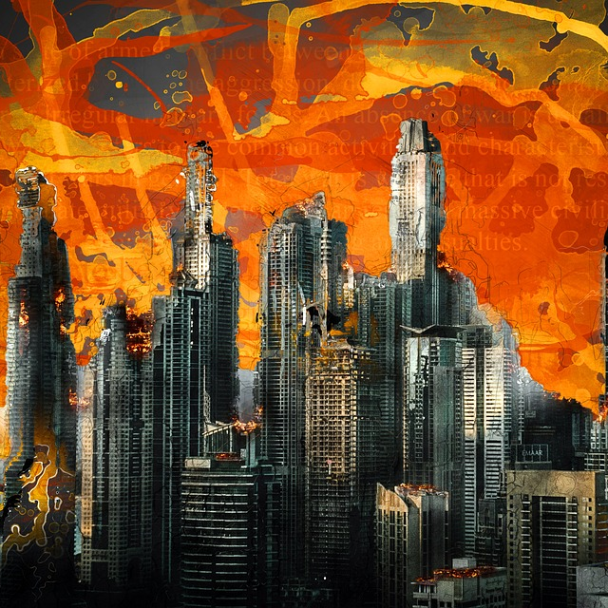
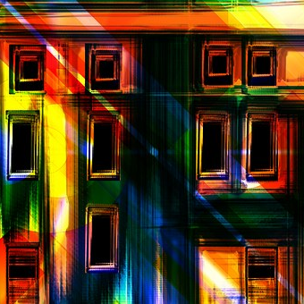
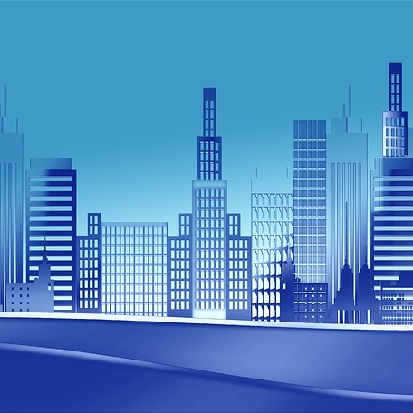
8. Cities as Order
The chaos of collective innovation, the structure of collective planning. Reflecting God the creator and the structurer of the universe (Gen 1).
Order and Chaos
“The rule of law” is a good British concept but our tendency to see legality as black and white issue is not helpful in the chaos of most urban life. For the person creating order has to live with certain healthy levels of ambiguity. To whom do you pay local rates? water rates? who controls the power distribution? who sets up the school boards? the boards that regulate alcohol? Cities are a diversity of multiple people-powers. A higgledy-piggledy jumbled-up patchwork of committees and bureaucracies. The very confusion is part of the distribution of power, the checks and balances needed to diffuse decision-making to the lowest possible level. Total order results in total power, and eventually total corruption.
City Building
Urban Planning is a process of advance envisioning of the growth of the city and creation of enforcable rules that enable some degree of maximization of the common good - a very historical phrase form Christian ethics, but one largely unknown, untaught in urban planning schools today

Slide 26
9. Cities as Soul
Soul as the integrator of meaning
God-ness
Godliness
Morality
Spirituality
Soul
In the Holy City, God himself is portrayed as being he light at the center. Without that connection to the divine eternal, cities denigrate into meaningless slavery of persons, for morality dries up, trust disappears, and oppression and exploitation, treachery and hatred divisions become normative. It is incumbent on us if we ae committed to the city, to extend the knowledge of the living God into the city squares, into every nook and cranny, every decision-making process.

Slide 27

10. City as Goddesses
The poetry of artistry
Imagination, innovation, artistry, fashion, architecture, art, design, creativity...
The Future City in an information age, has to be a creative and innovative city, one that can stay at the forefront of creating new products.
Charles Landry has focussed his writings on this theme

Slide 28
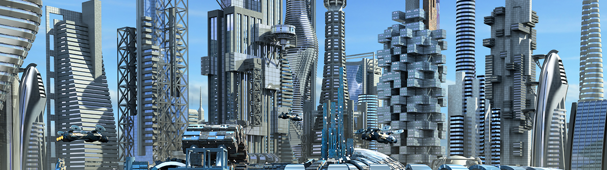




Creative Cities
Creating Environments of economic, social and political freedom…
…the fruit of the Spirit in the public square over multiple generations
… the emulation of the fruit of the Spirit in societies that do not know him.
Creativity
Innovation
Entrepreneurship
A society that encourages creative thinking, creative action, individuality within boundaries, art, music, poetry, philosophy…
A population that has liberty to achieve freely, because basic needs, and social needs are met…
Economic liberty, freedom of capital, based on clarity of ownership of land and businesses, in a context of trust and good law…

Slide 29

11. Cities as Thought Processes
What mazeways are we creating for this city?
The thinking city…
Many of the great European cities were built around the university. The University provides a context for free thought, for philosophy as well as education in the disiplines that are needed to sustain urban structures. .
A secondary level is that of technical training for a significant percentage of the population whose hands are the genius of production in the city.
AS these become centers of unique thinking and development of economic sectors o f the city, academic-bsuienss partnerships facilitated by wise political leadership can uplift the city decade after decade into new leading productive sectors.

Slide 30
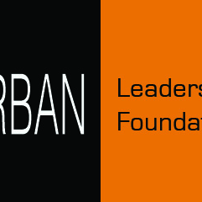



Contact Us!
Urban Leadership Foundation
admin@urbanleaders.org
+1 6262538411

Slide 31
Thank You for Watching!
Any Questions?
Viv Grigg- http://www.urbanleaders.org
Used Font: Route 159 Family & Open Sans Family
Icon: Font Awesome, the author is Dave Gandy (Changed the color by Photoshop)
Typicons, the author is Stephen Hutchings (Changed the color by Photoshop)

